Slide 1
Install vSAN
Lecturer: Ngo Huy Bien
Software Engineering Department
Faculty of Information Technology
University of Science
Ho Chi Minh City, Vietnam
nhbien@fit.hcmus.edu.vn

Slide 2

Objectives
To install vSAN.
To configure vSAN.

Slide 3

Contents

Slide 4

References
Nick Marshall et al. (2018). Mastering VMware vSphere 6.7. Sybex.

Slide 5
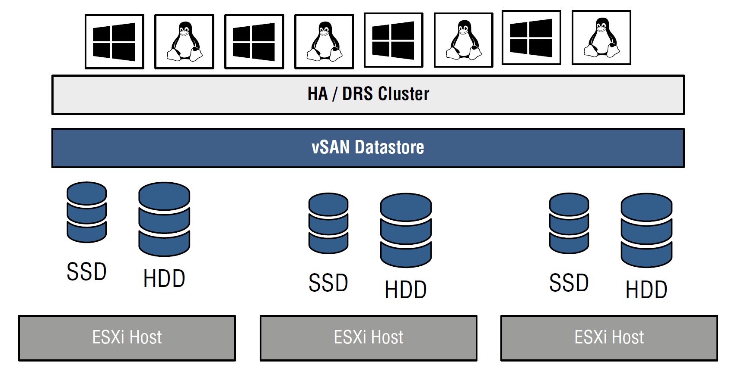
Virtual SAN (vSAN) [1]
vSAN abstracts the ESXi host's local disks and presents them to the entire vSAN cluster to consume.

Slide 6
vSAN Terminologies
vSAN doesn't use the traditional RAID concepts. vSAN uses a combination of vSphere APIs for Storage Awareness (VASA) and storage policies to ensure that VMs are located on more than one disk and/or host to achieve their performance and availability requirements. This is why VMware recommends 10 Gbps networking between ESXi hosts when using vSAN.
A disk group is a unit of physical storage capacity on a host and a group of physical devices that provide performance and capacity to the vSAN cluster.
After vSAN is enabled on a cluster, a single vSAN datastore is created.

Slide 7
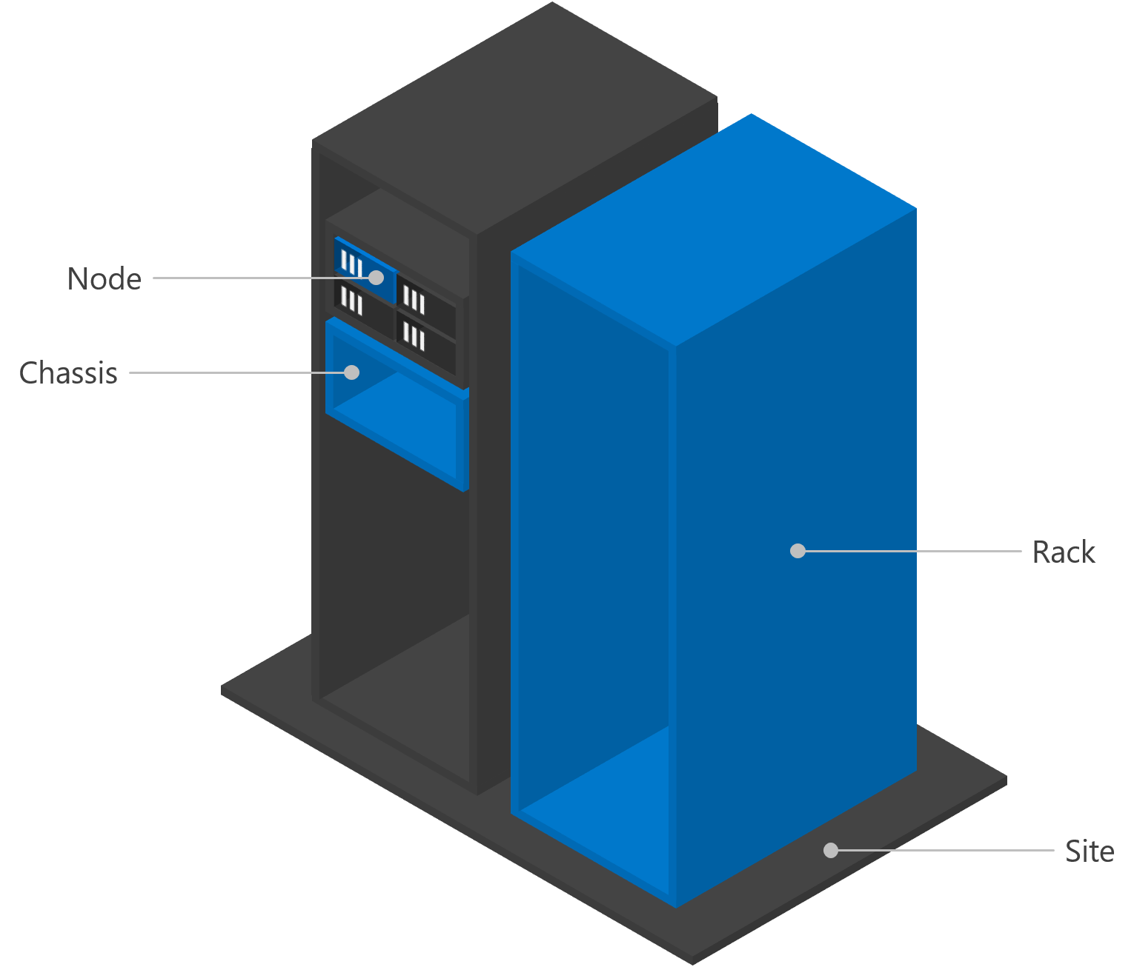
Fault Domain
A fault domain is a set of hardware components that share a single point of failure.
To be fault tolerant to a certain level, you need multiple fault domains at that level. For example, to be rack fault tolerant, your servers and your data must be distributed across multiple racks.
There are four canonical levels of fault domains - site, rack, chassis, and node.
Nodes are discovered automatically; each additional level is optional. For example, if your deployment does not use blade servers, the chassis level may not make sense for you.

Slide 8
vSAN and vCenter Server
vSAN requires vCenter Server to operate.
This is because vSAN is a distributed storage solution that is tightly integrated with the VMware vSphere ecosystem, and all management and configuration tasks for vSAN are performed through vCenter.

Slide 9
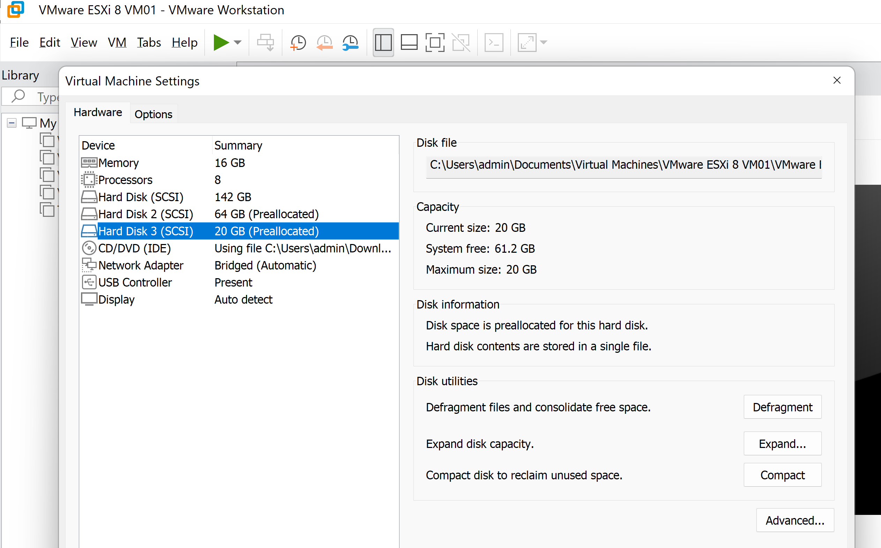
1. Create a Disk

Slide 10
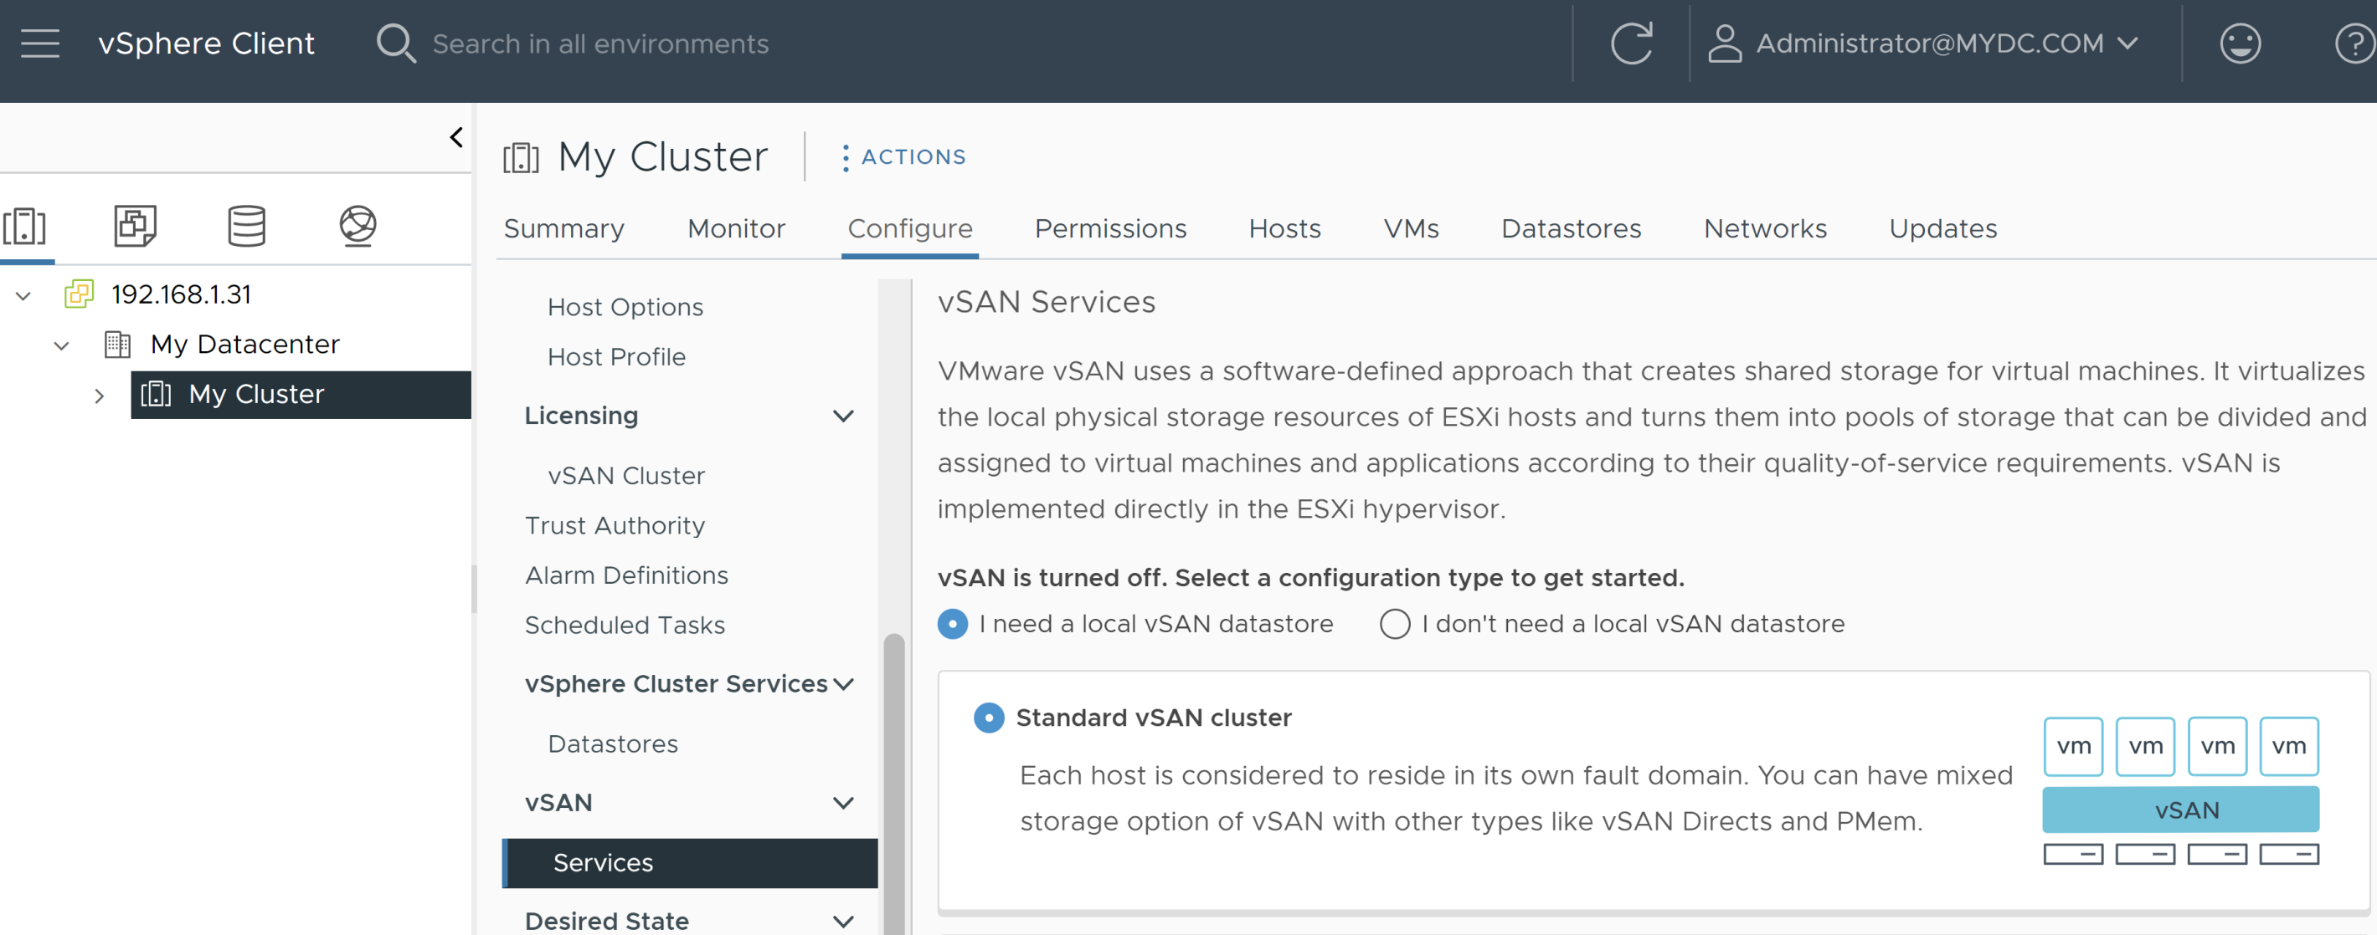
2. Select vSAN Configuration Type
This is configured for a cluster.

Slide 11
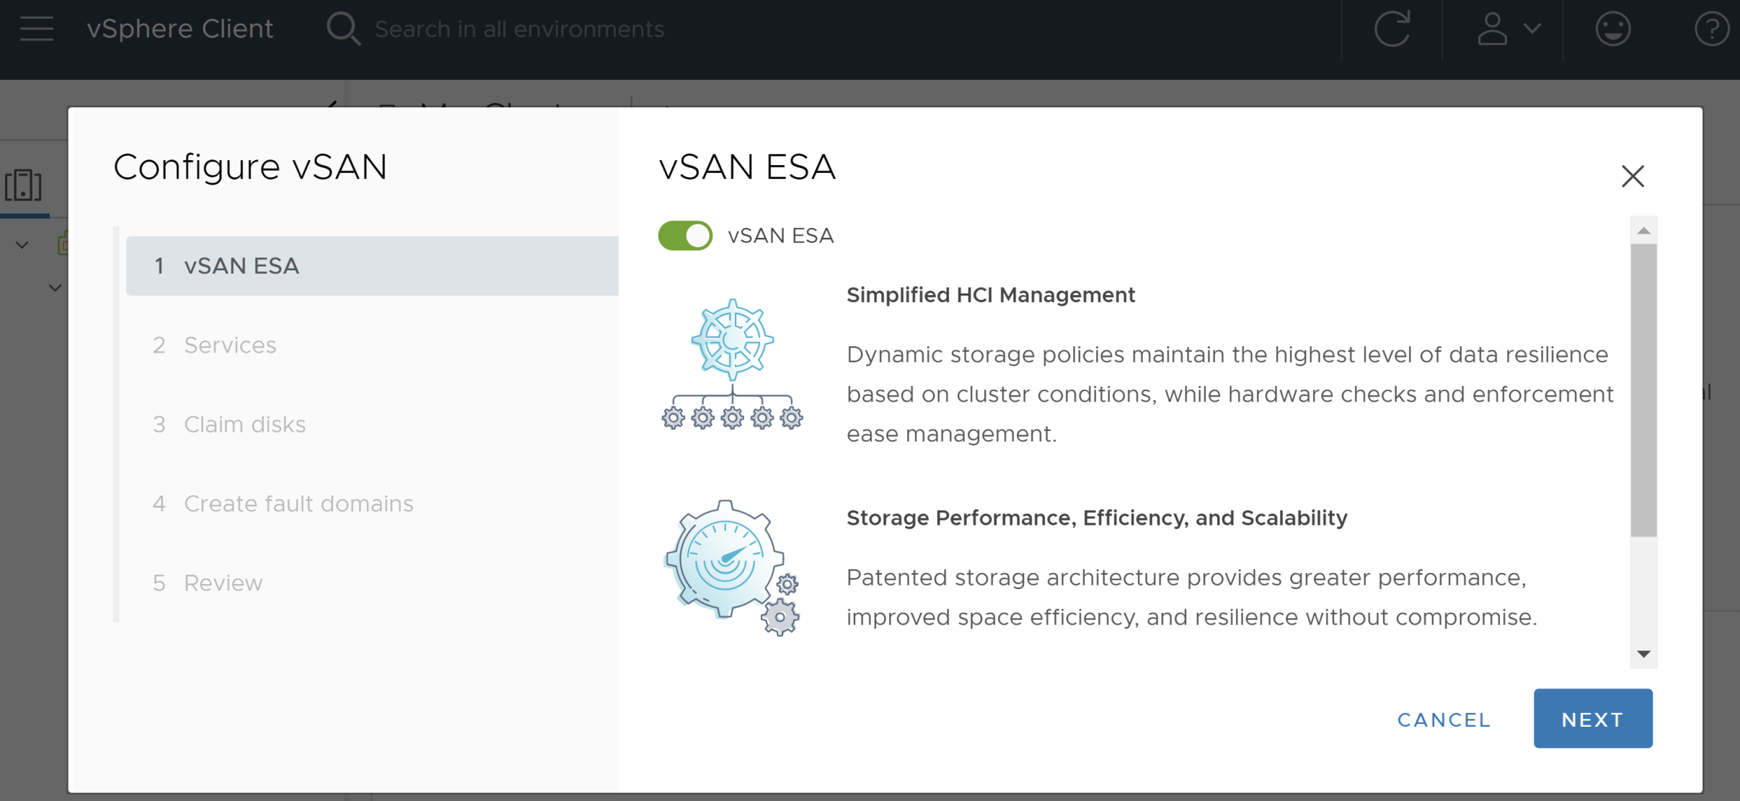
3. Enable vSAN ESA
ESA = Express Storage Architecture.
Hyperconverged infrastructure (HCI) is a software-defined, unified system that combines all the elements of a traditional data center: storage, compute, networking and management.

Slide 12
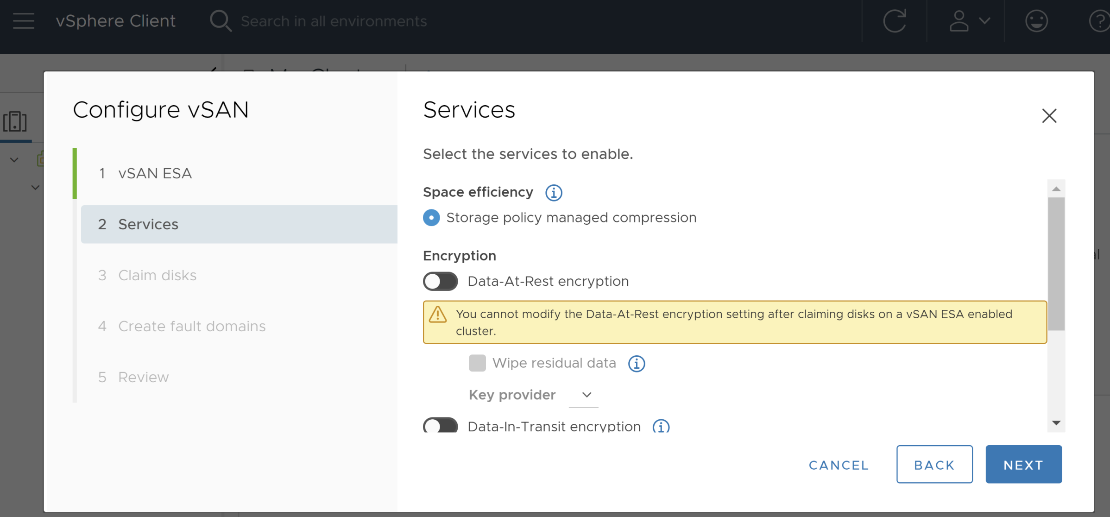
4. Enable vSAN Services

Slide 13
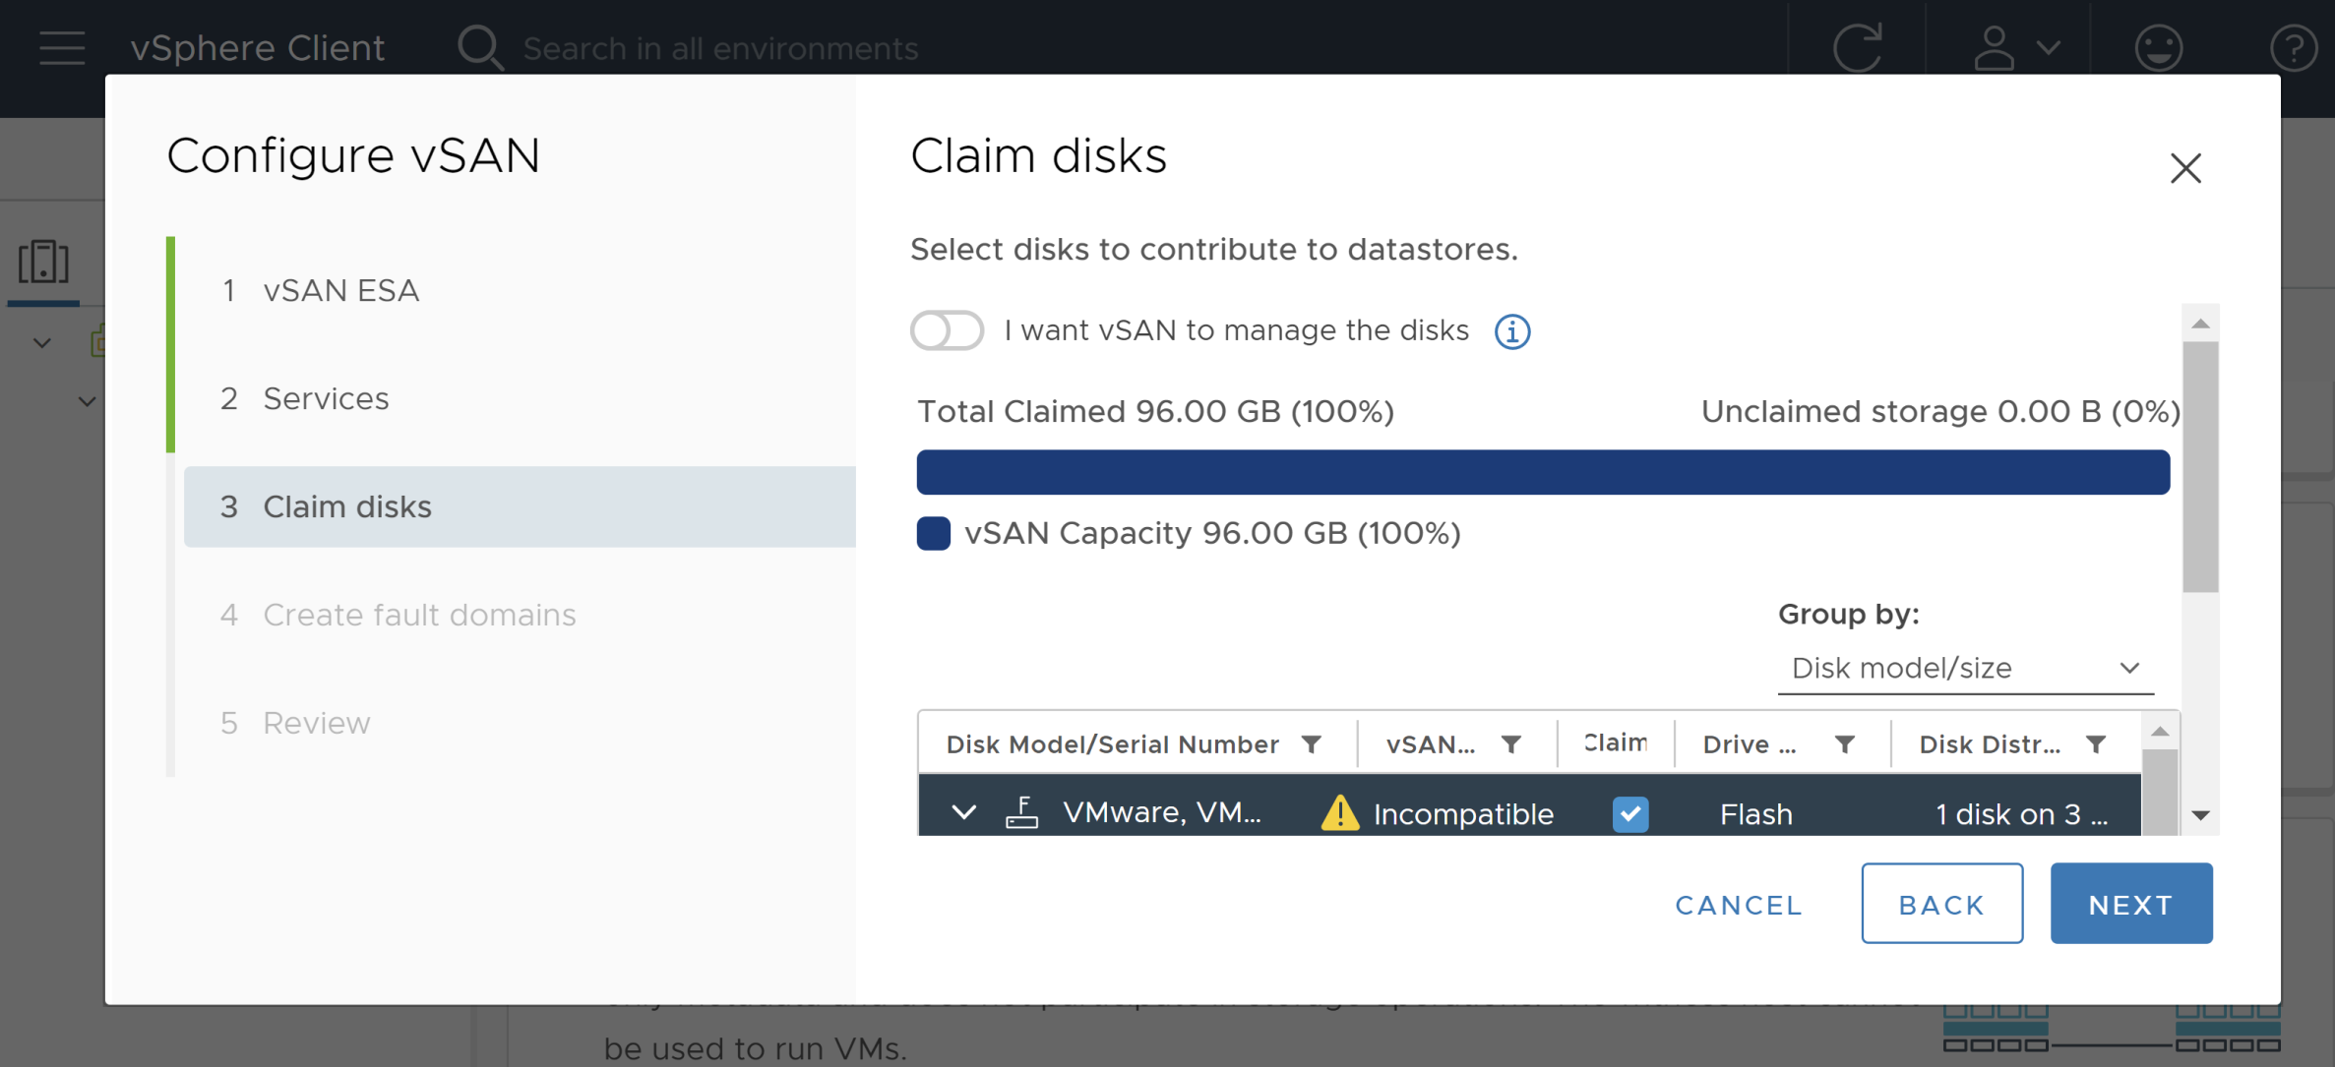
5. Claim Disks

Slide 14
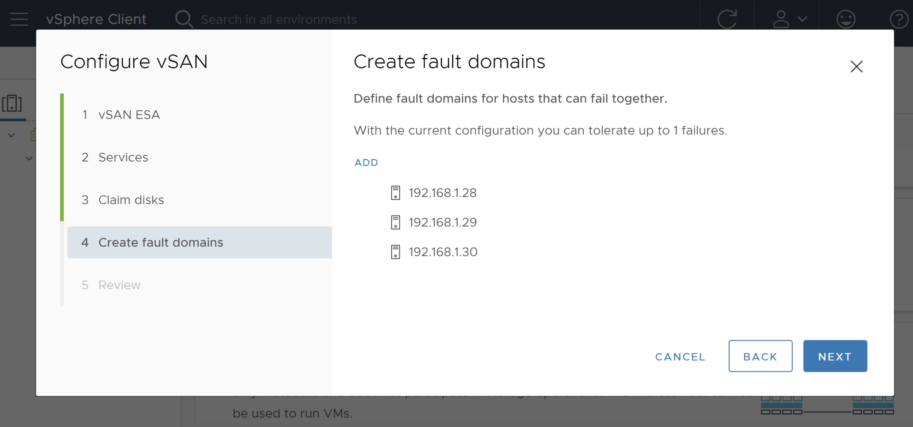
6. Create Fault Domains

Slide 15
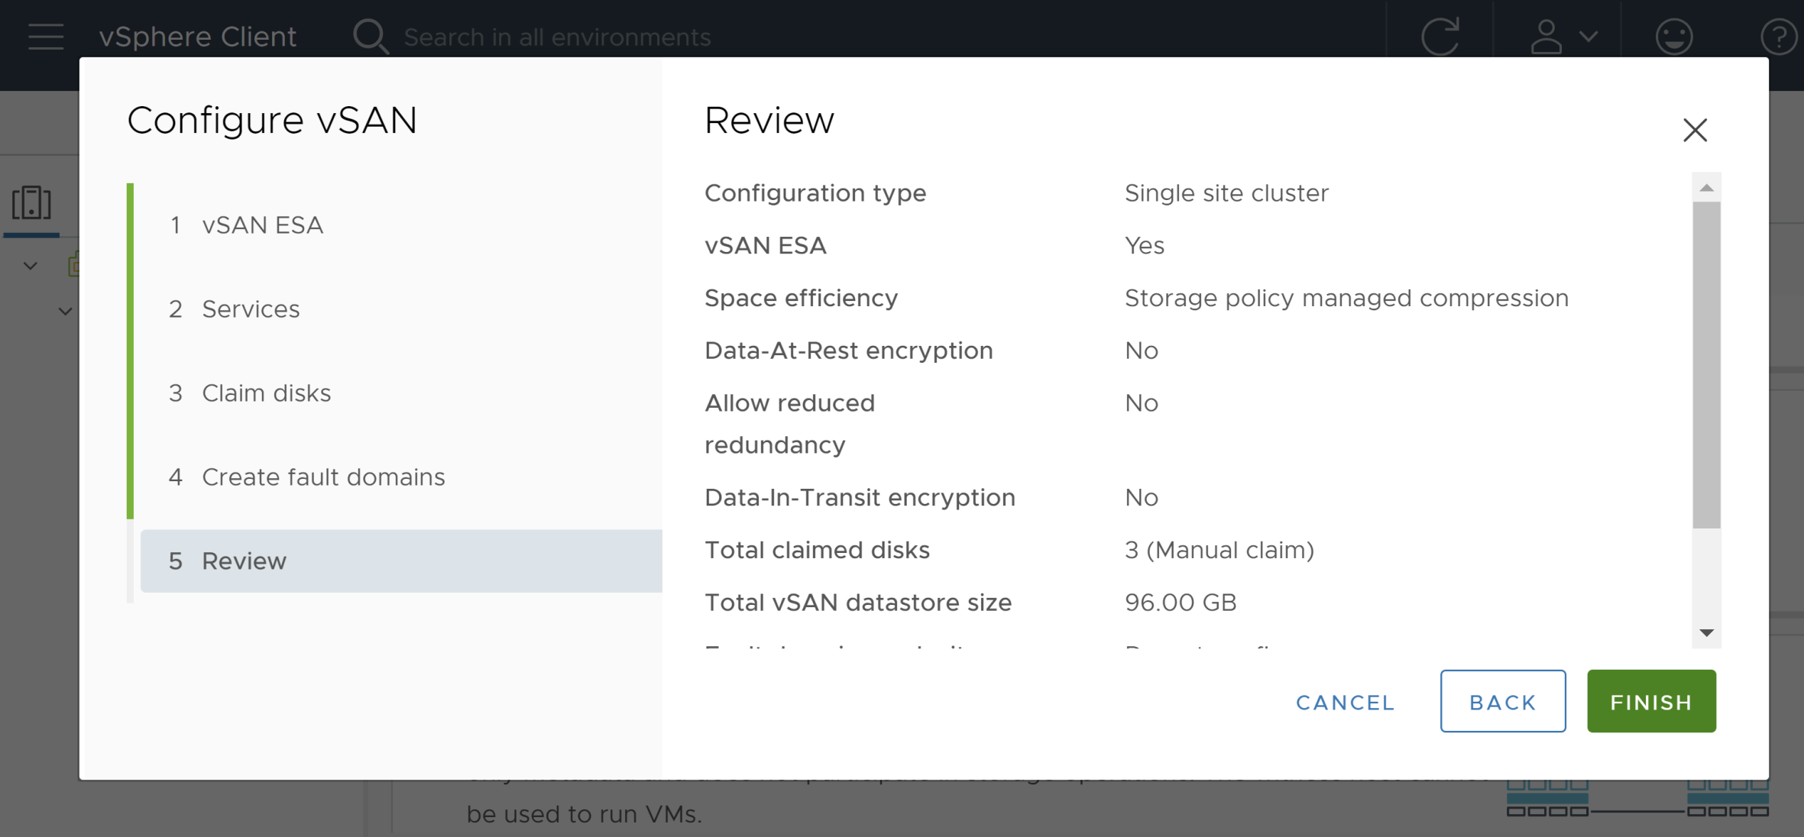
7. Review Configuration

Slide 16
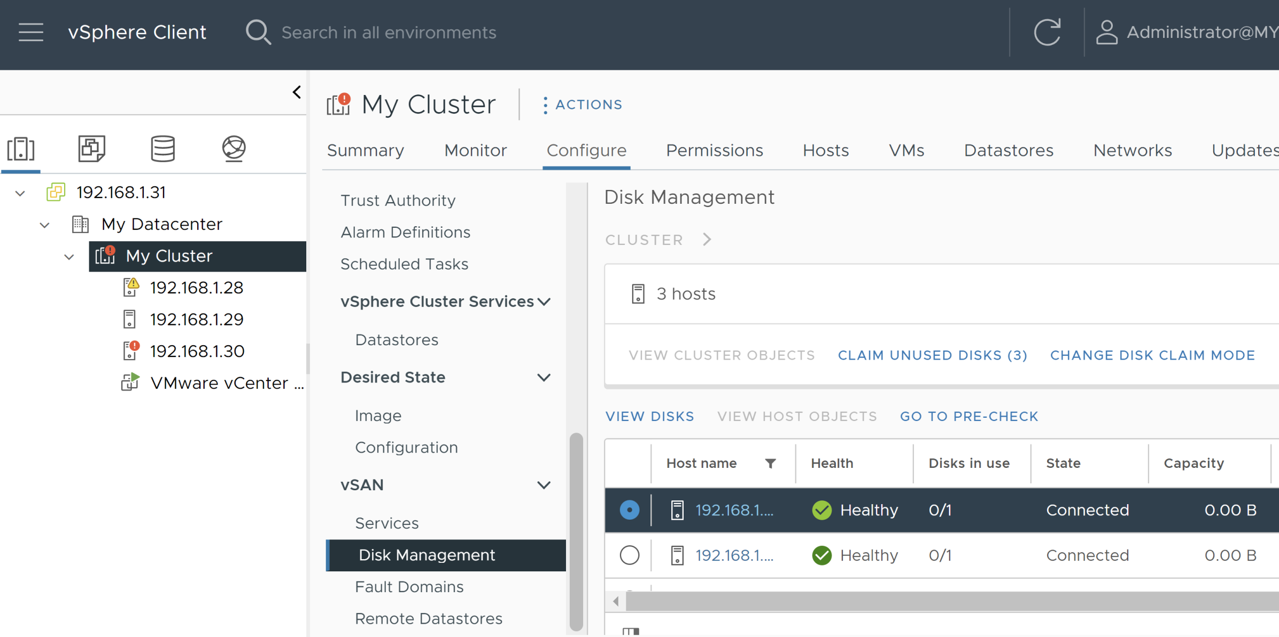
8. Claim Unused Disks

Slide 17
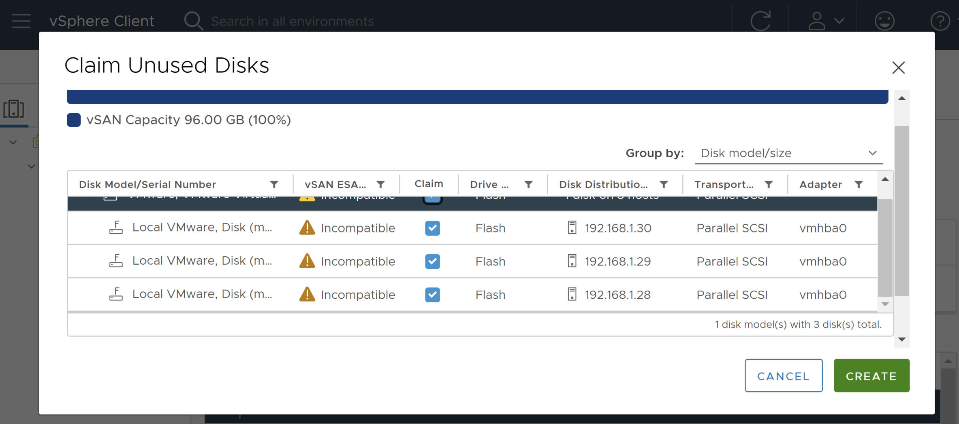
9. Create Disks

Slide 18
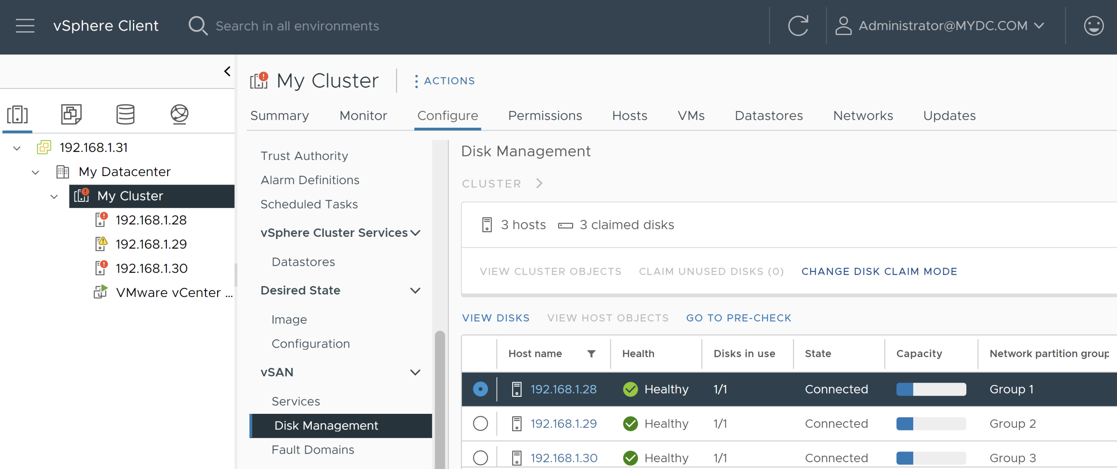
10. Review Disks

Slide 19
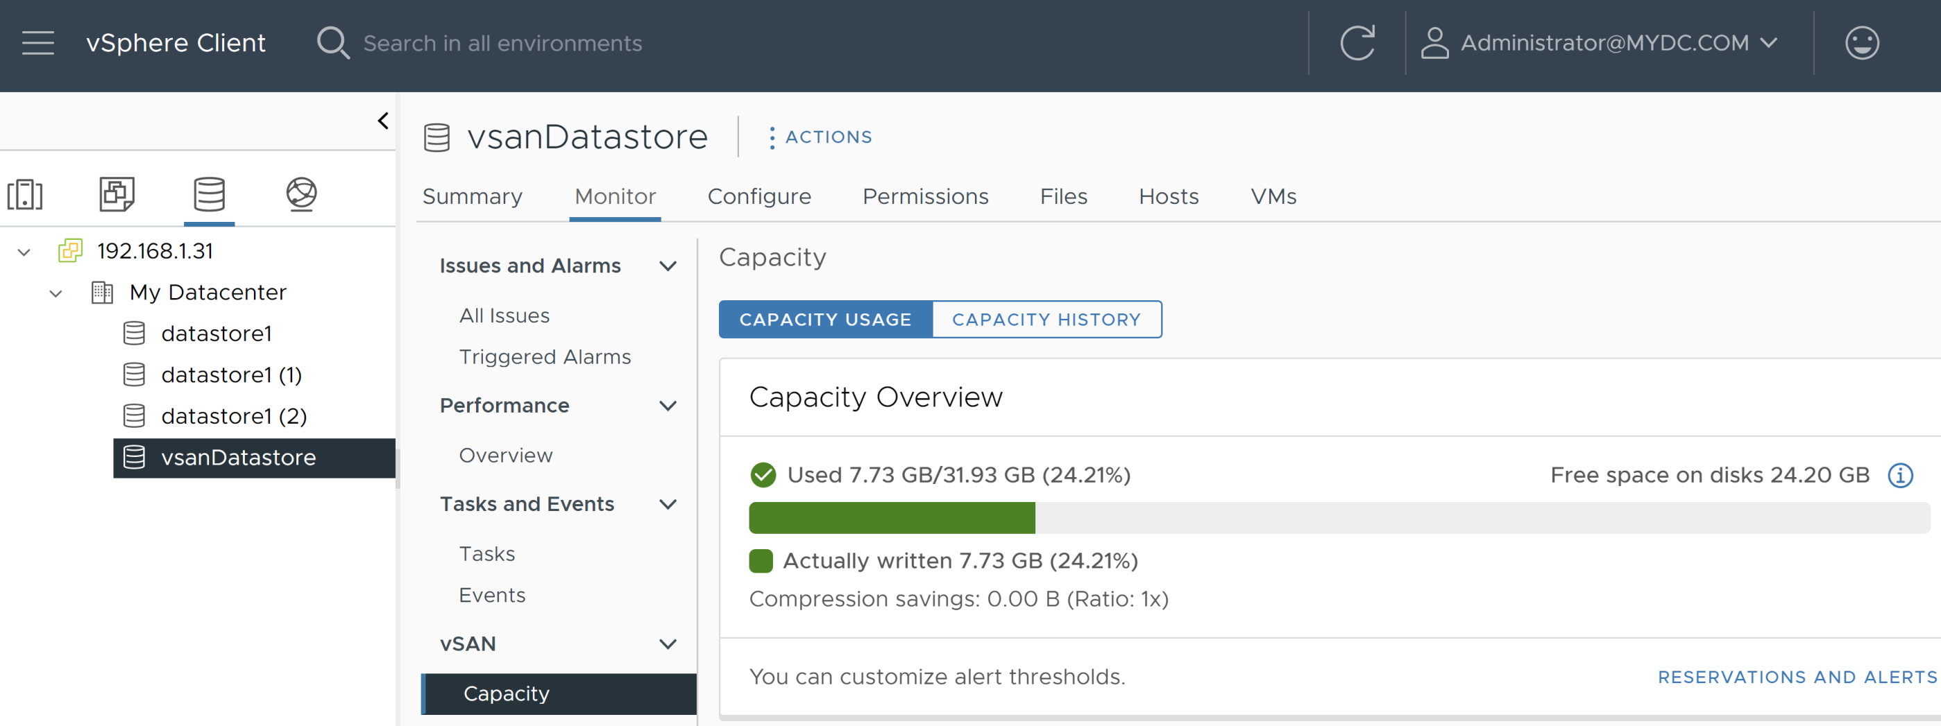
11. Review vsanDatastore
This vsanDatastore datastore is automatically created by vSAN.

Slide 20

Thank You & See You Again

